Slide 1
The Deadliest Catch
David Prindle || Derek Welker || Brian Youngman || Suhail Prasathong

Slide 2
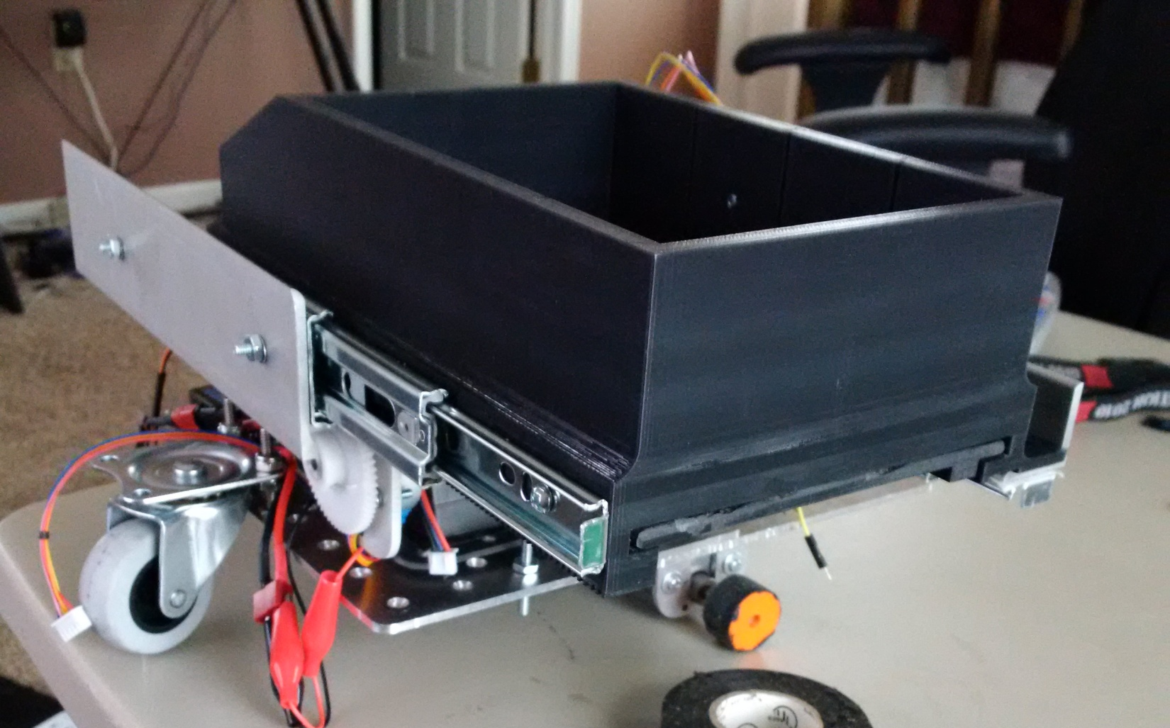
Table of Contents
Project Overview
Design Evolution
Robot Operation
Electronics & Software
Fabrication Methods
Design Analysis
Team & Technical Analysis

Slide 3
Project Overview
The American Society for Engineering Education requests that a robot must be designed, manufactured and tested in order to acquire, sort and dispose of colored fish.
The robot must place the colored fish in its corresponding drop off point within the arena.
The robot has a size limitation of 8x10x12 inches
Robot must collect and dispose of 12 fish
Robot must complete the task within 2 minutes. Points will be deducted for any time over.

Slide 4
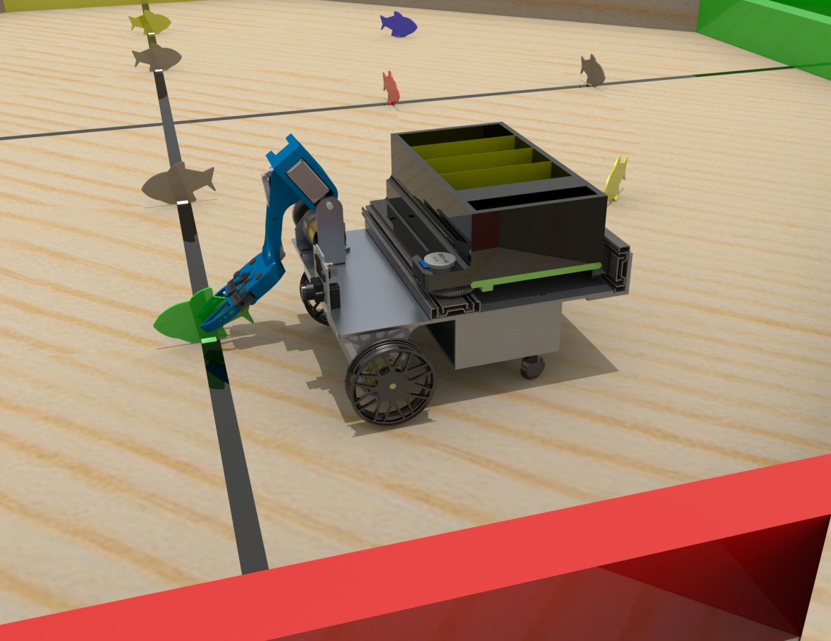
Design Evolution
Step through revisions
SOLIDWORKS Models
First draft to Final model

Slide 5
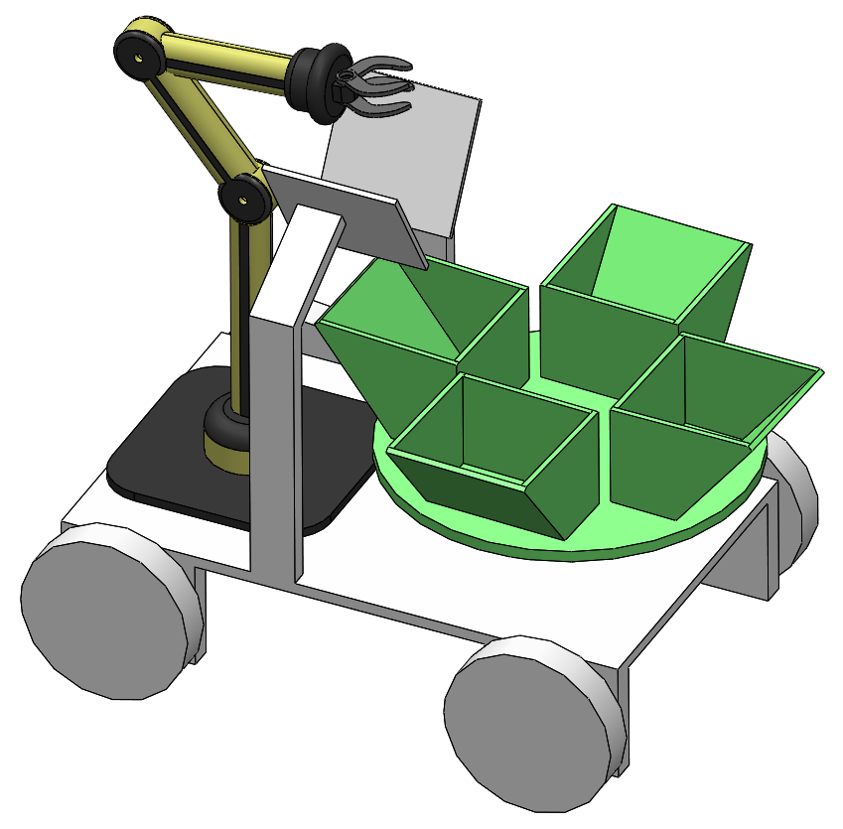
First Revision
Individual containers for each color
Rotating base
Robotic arm

Slide 6
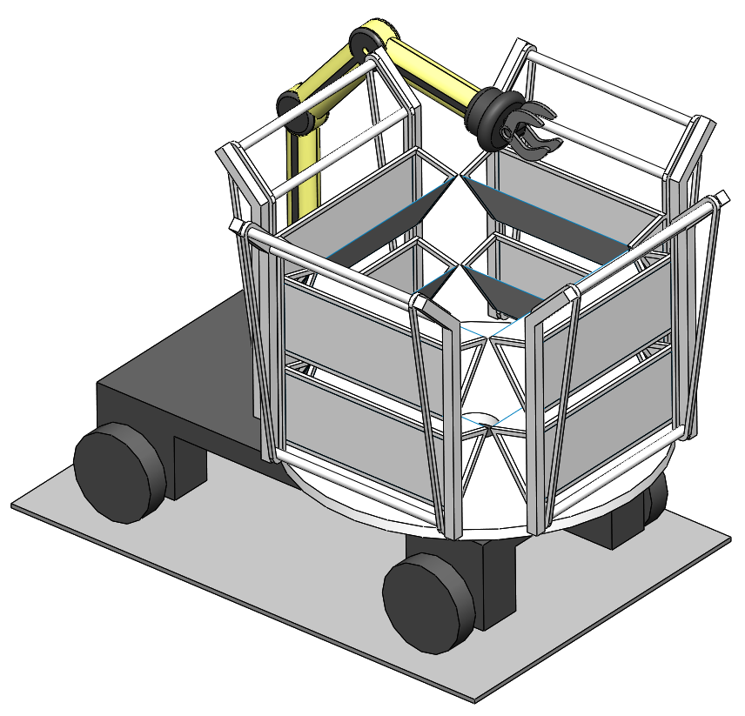
Second Revision
Rotating base plate
Individual buckets on pulleys
Storing system is also the drop off mechanism

Slide 7
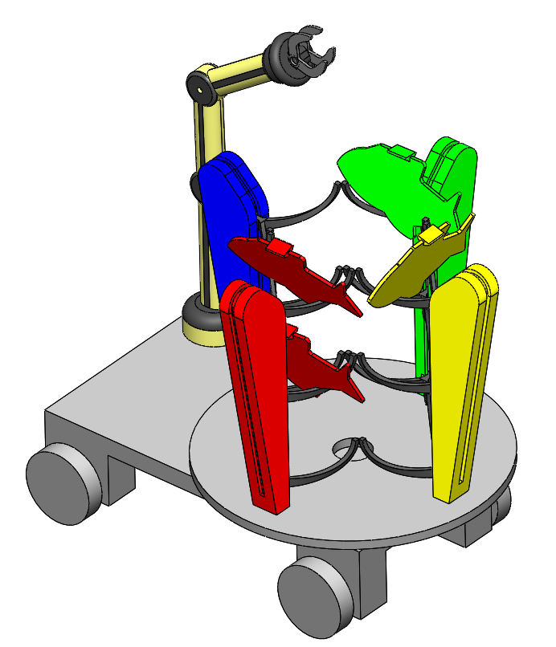
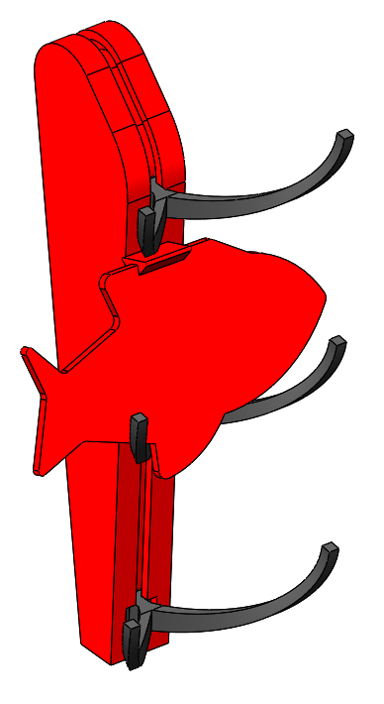
Third Revision
Modified “Buckets”
Conveyor slots
Holding arms

Slide 8
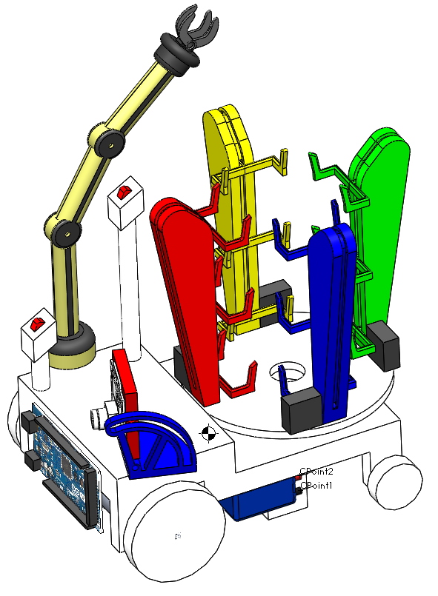
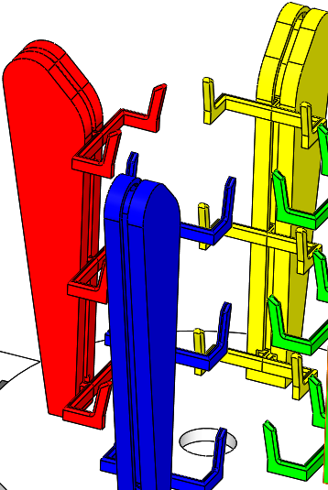
Fourth Revision
Up & down switch
PIXY adjuster
MEGA & Battery Incorporated
Modified Arms

Slide 9
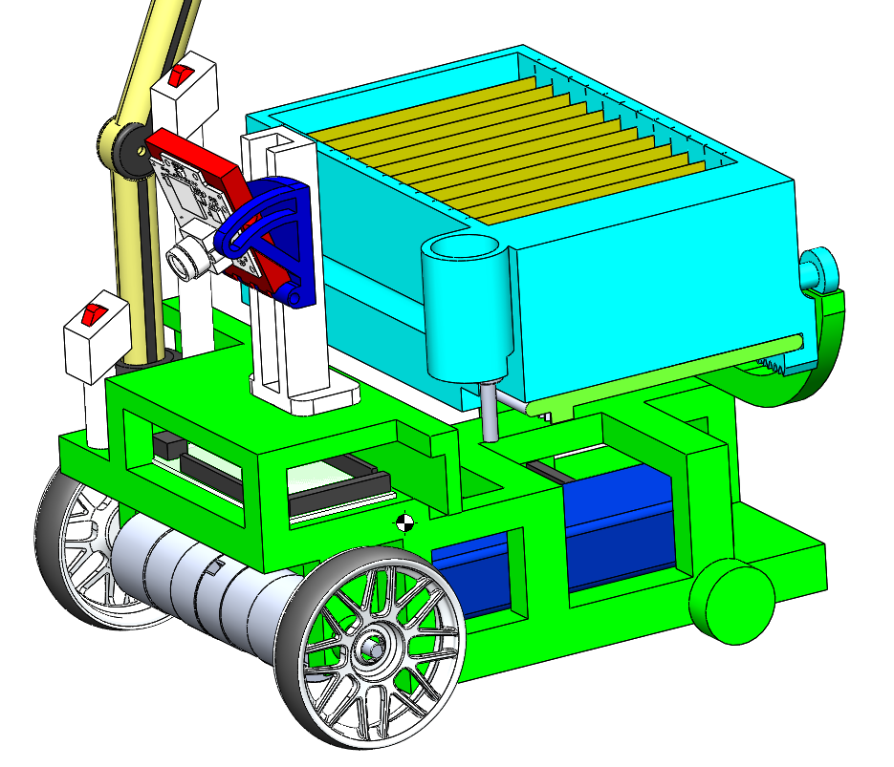
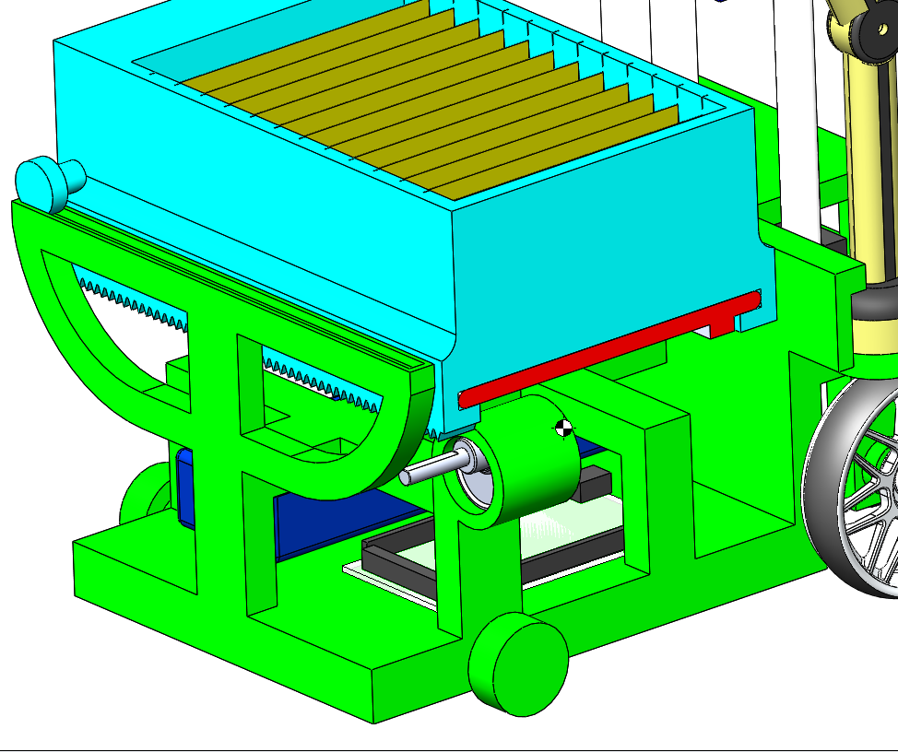
Fifth Revision

Slide 10
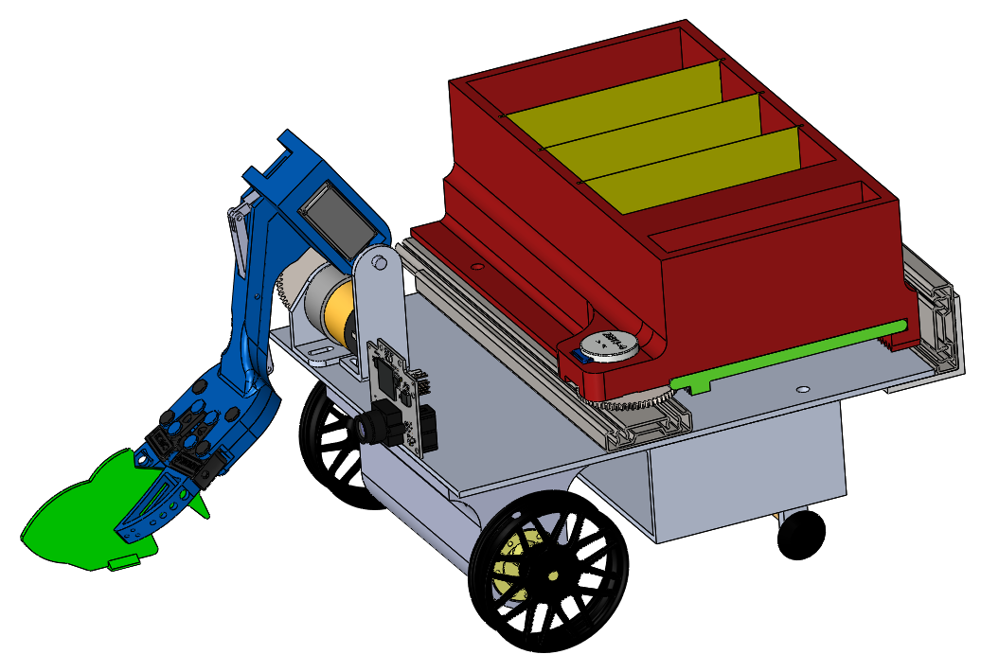
Final Revision

Slide 11
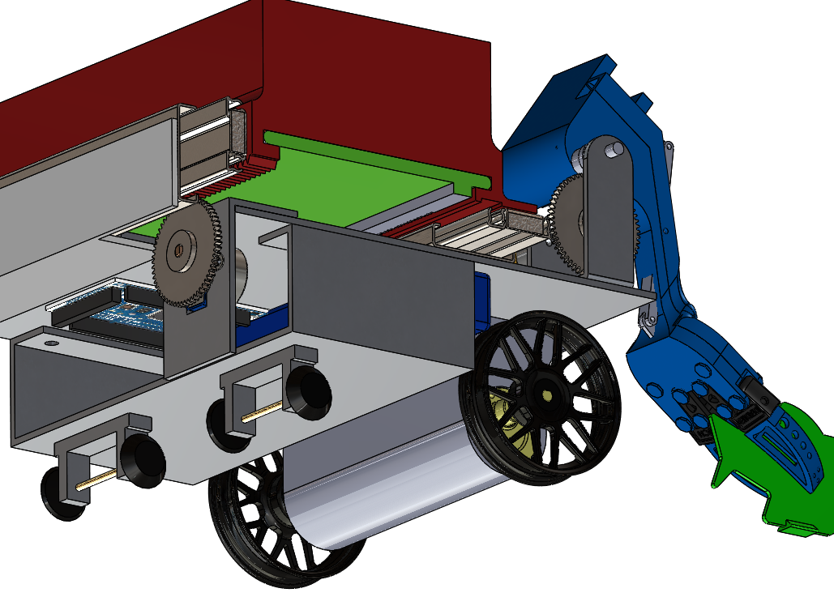
Final Revision

Slide 12
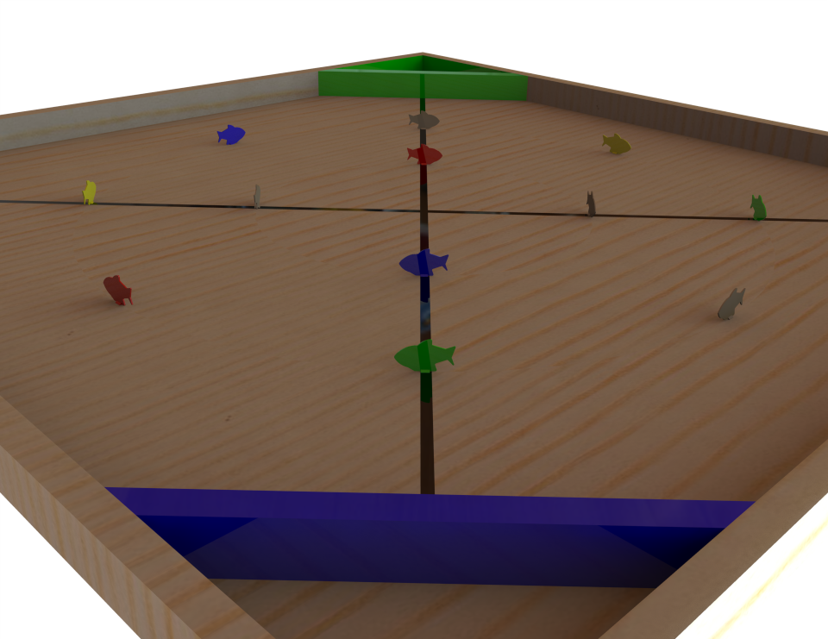
Robot Operation
Explain Pickup, Sorting, Storing and Drop Off Mechanism
“The Claw”
PIXY Camera
3D Printed Bucket System
Slide out Tray

Slide 13
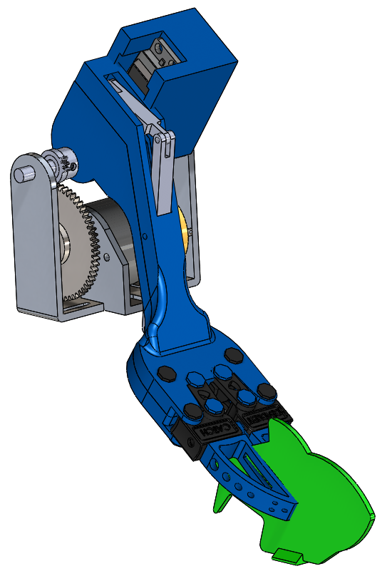
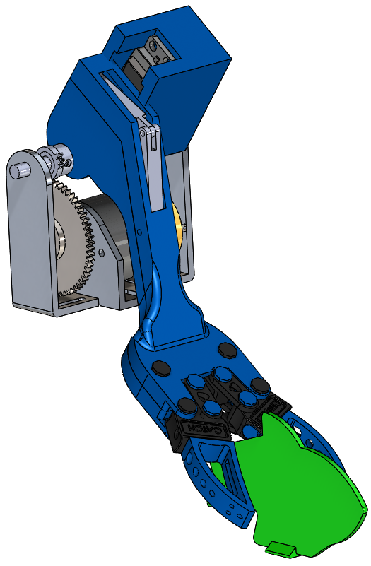
Pickup Mechanism – The Claw
Servo attached to linkage opens and closes the claw
3D Printed
Stepper motor rotates the arm
Modeled to exact size requirements

Slide 14
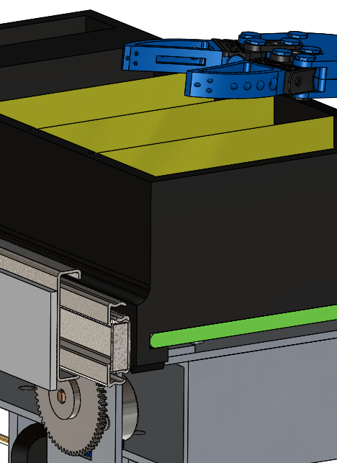
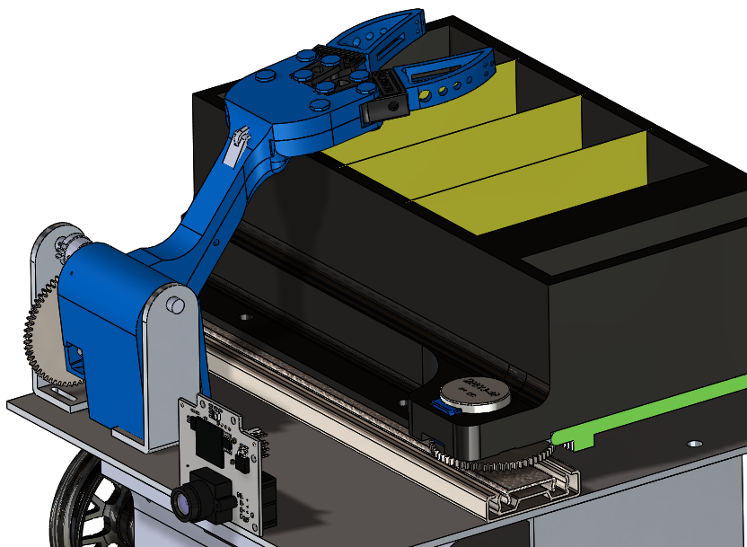
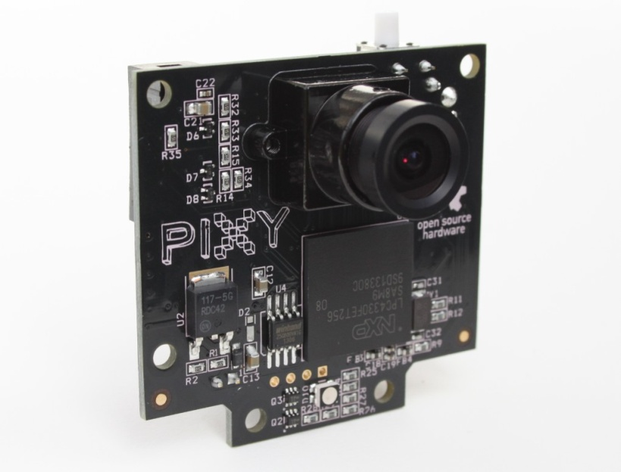
Sorting Mechanism – PIXY & Bucket System
PIXY Camera
3D printed container
Drawer slides
Stepper motor drives container back and forth

Slide 15
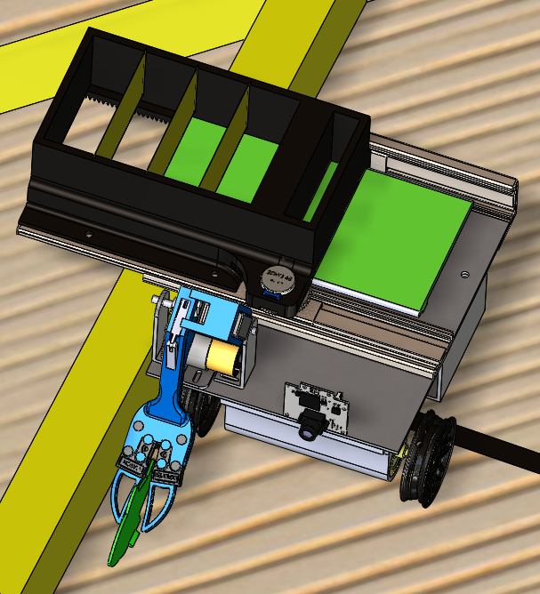
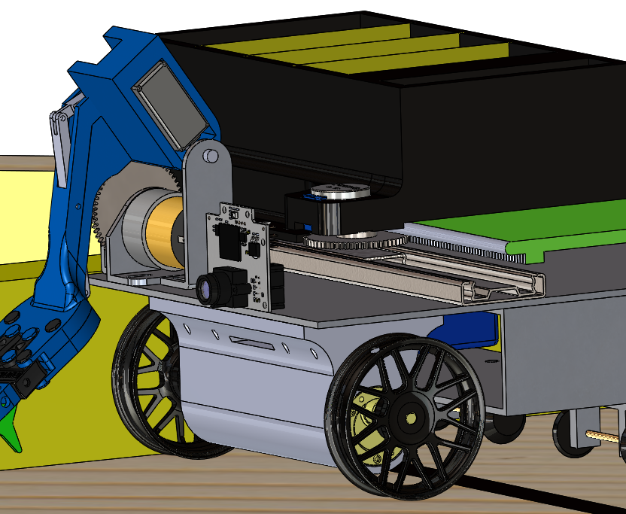
Storing & Drop off Mechanism
Stepper moves container out
Stepper pulls the “floor” back
Slide Out Tray
Section for each color

Slide 16
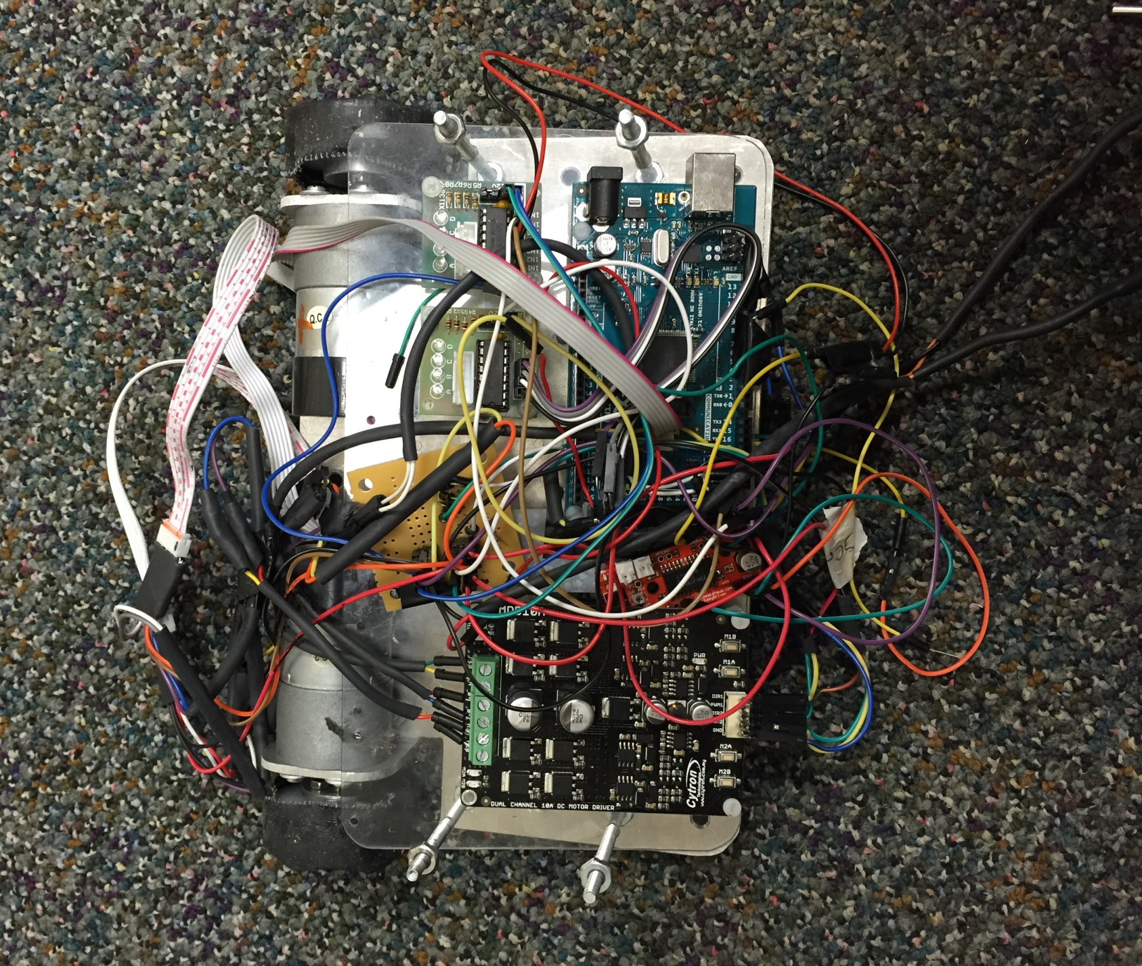
Electronics and Software
Circuit Diagram
Flow Chart
Electrical Components
Programming Code

Slide 17
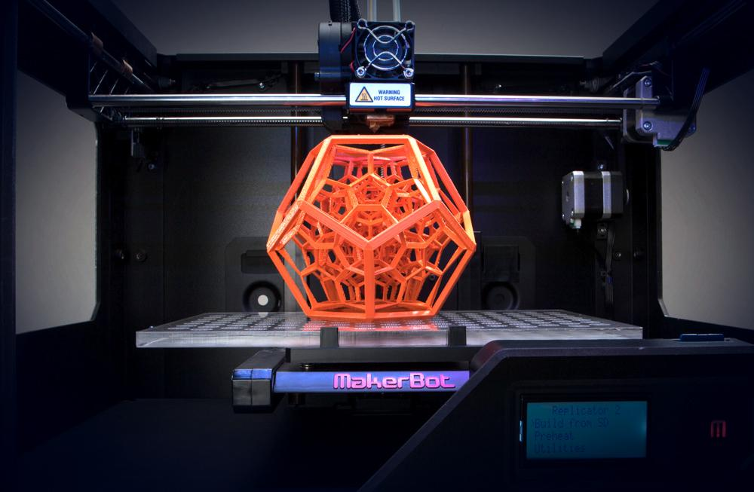
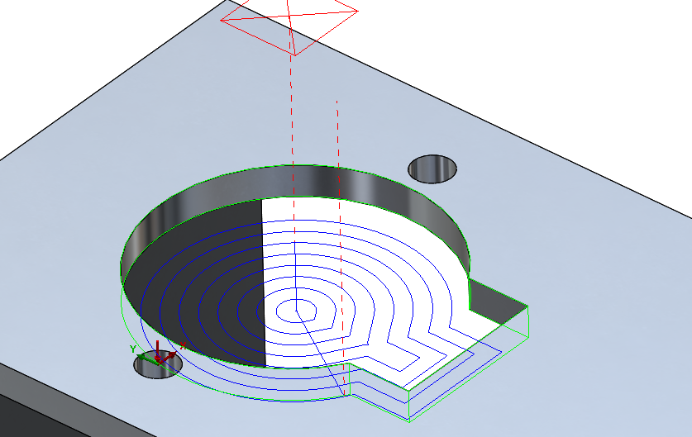
Fabrication Methods
3D printing
Machined Components
Purchased Parts

Slide 18
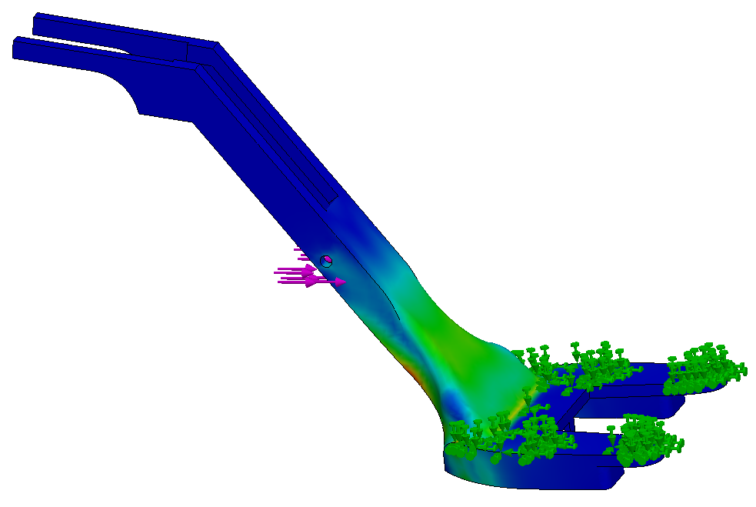
Design Analysis
Robot Testing
Sustainability
Bill of Materials
Time and Labor Spreadsheet

Slide 19
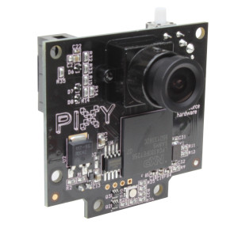
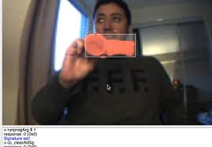
Sensors
Pixy Cam
Color Identification
Size and location
Arduino libraries
ICSP connection

Slide 20
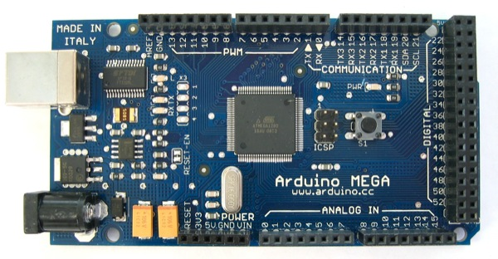
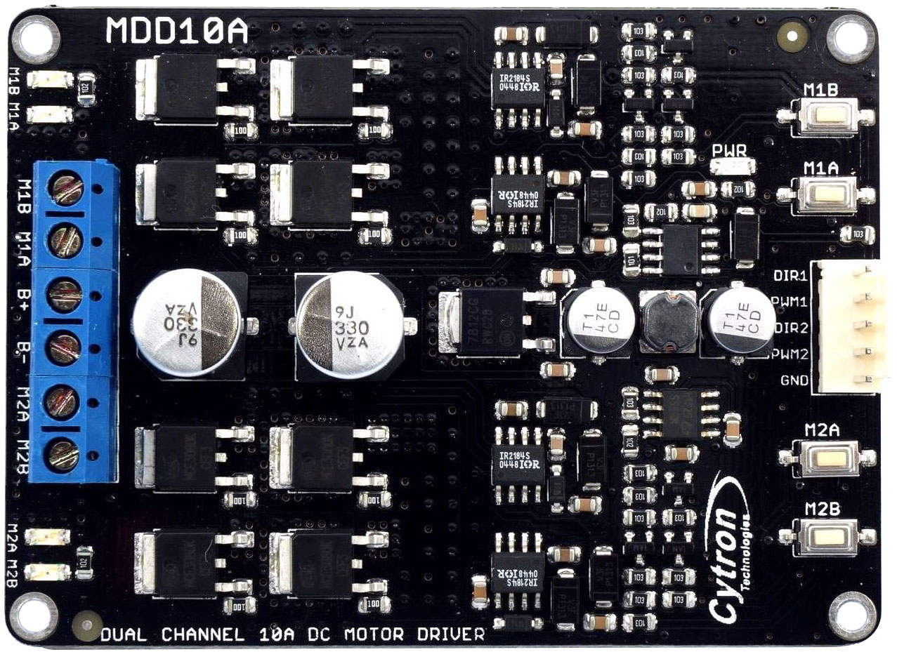
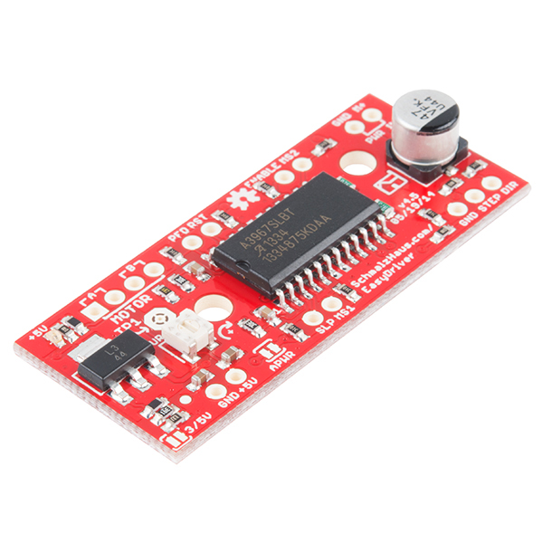
Electronics
Mega
54 digital pins
Open source libraries
6 interrupt pins
10A
Dual motors
700ma per phase

Slide 21
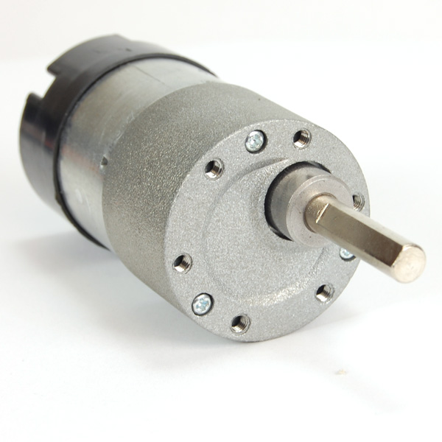
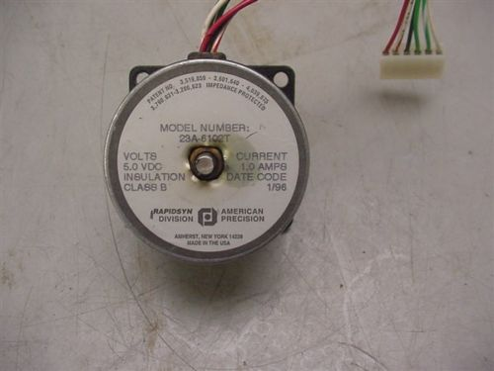
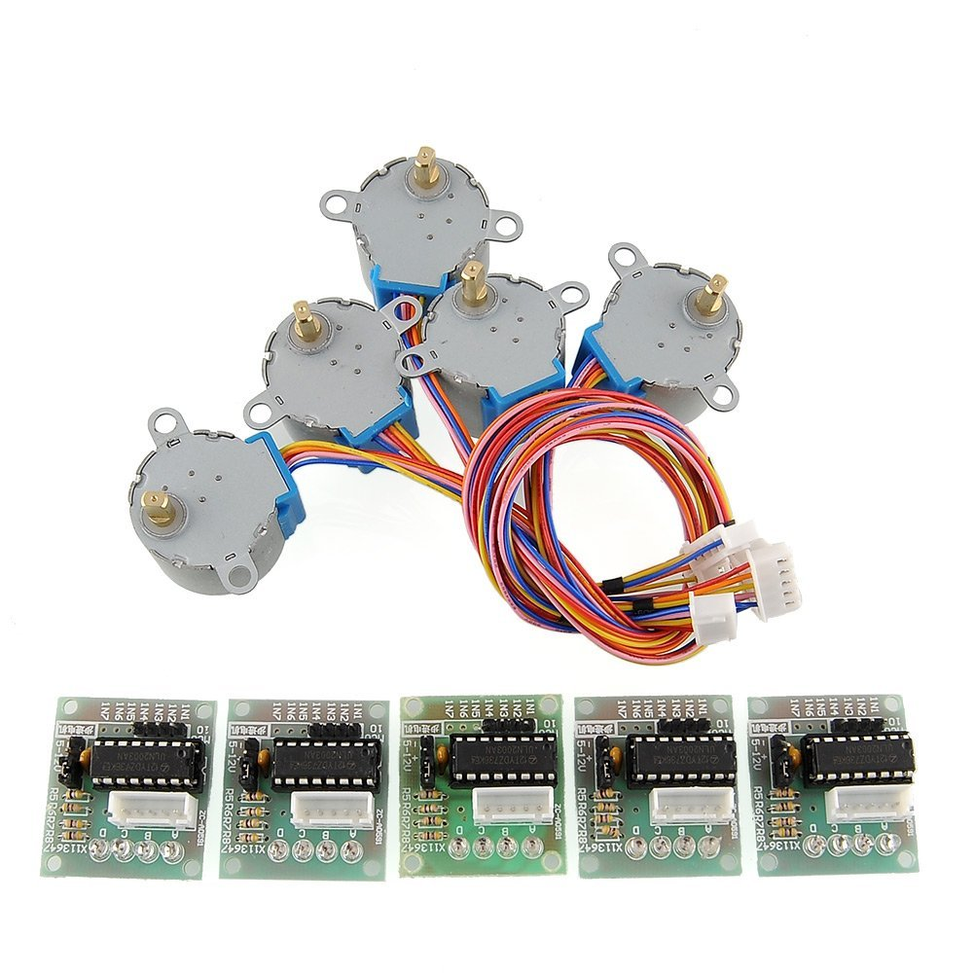
Motors
40:1 gearing
Built in Encoders
3A
5v 1A
Unipolar set up as Bipolar
5v 150ma
Motor Controller

Slide 22
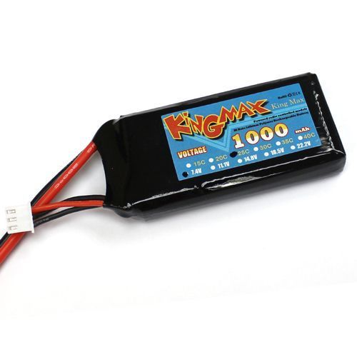
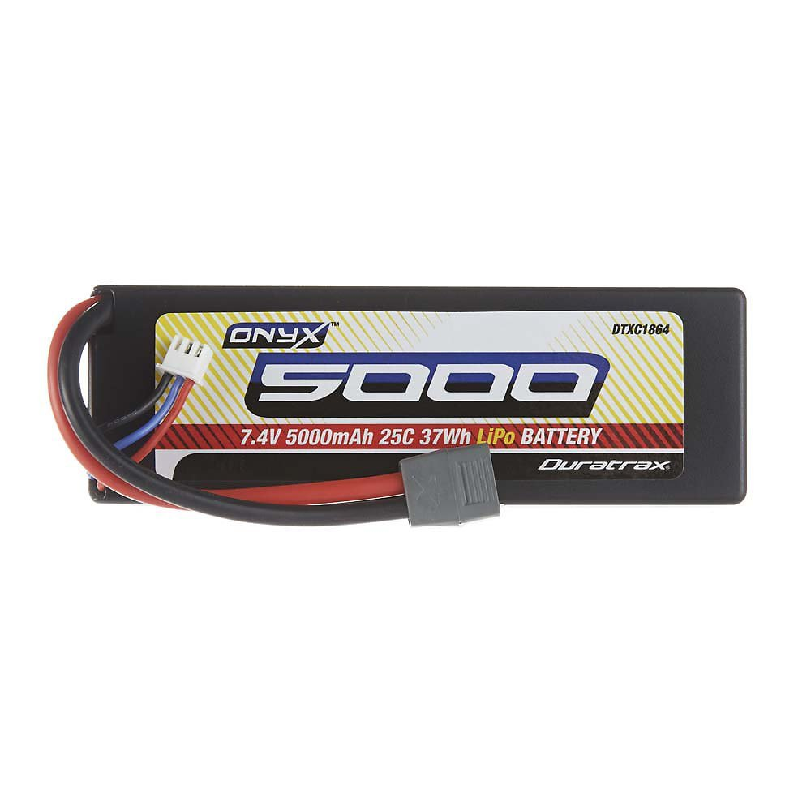
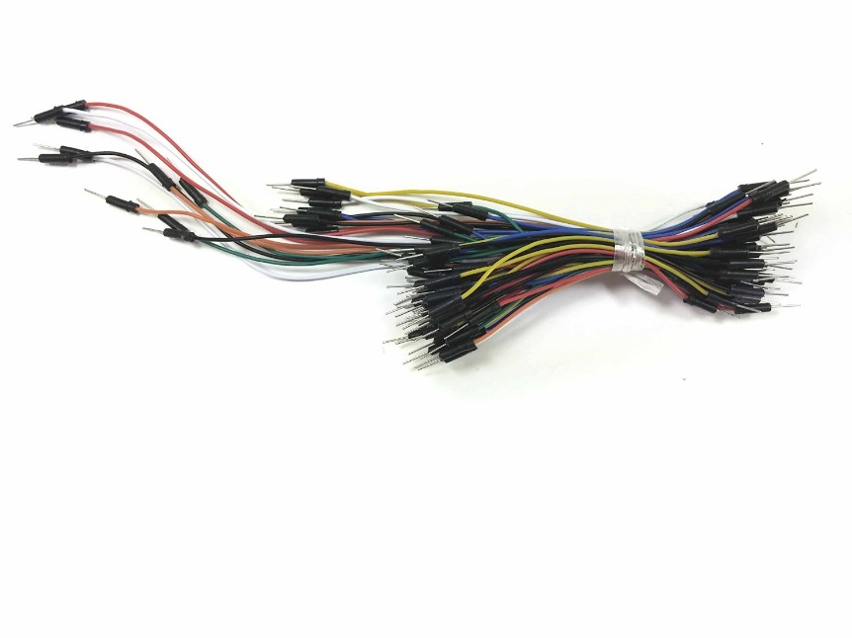
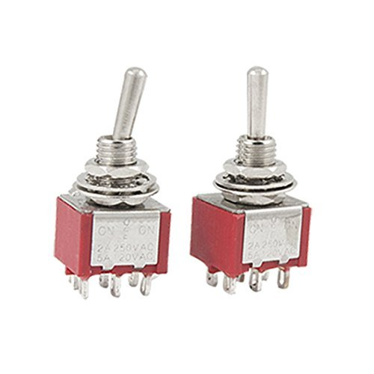
Power and Miscellaneous
M/M F/F M/F
Toggle Switches
7.4V LiPo
1000mAh
Arduino
7.4v Lipo
5000mAh
Motors

Slide 23
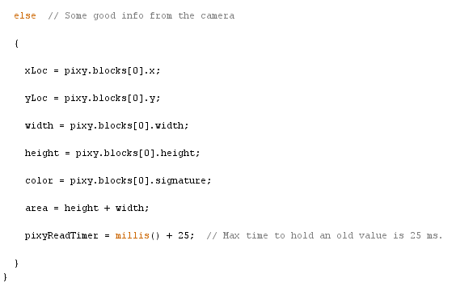
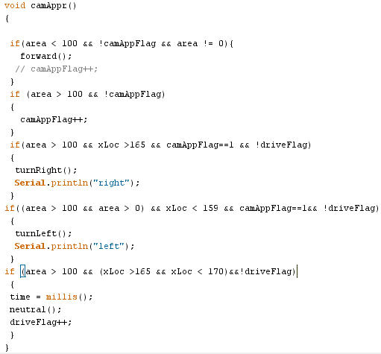
Camera Code

Slide 24
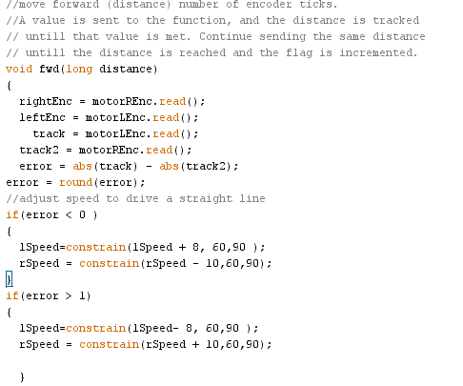
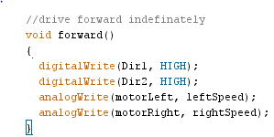
Drive Code

Slide 25
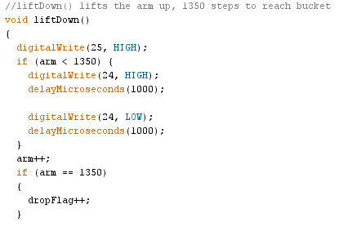
Pick Up code

Slide 26
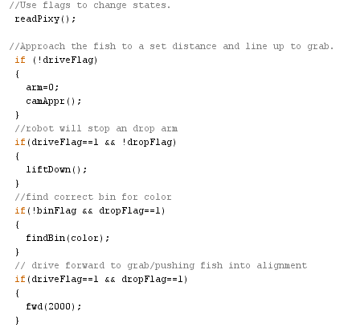
Main Loop

Slide 27
Robot Testing

Slide 28
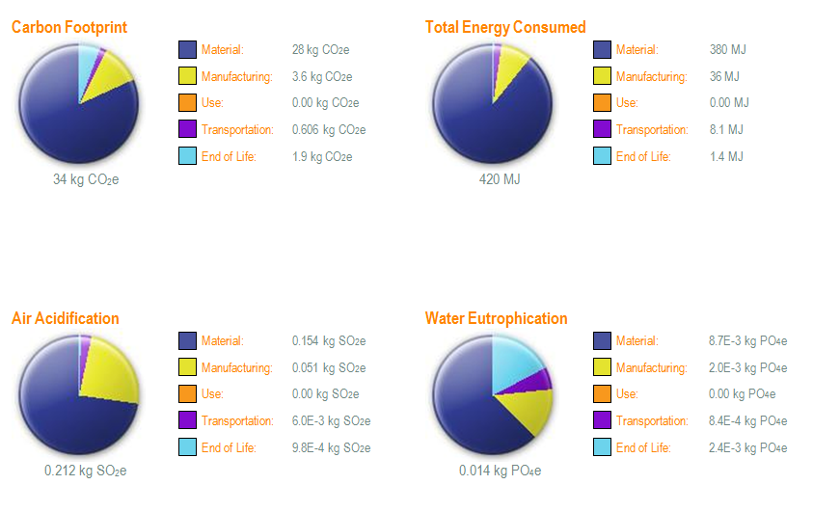
Sustainability

Slide 29
Materials
Printed | Machined | Bought | Electronics
Bucket | Top Chassis Plate | Fasteners | Arduino Mega
Wheels | Lower Chassis Plate * | Drawer Slides | Pixy Cam
Vibration Motor | Rear Stepper Bracket | Stepper "L" Brackets | 7.4V 1000mAh battery
Claw | Servo Bracket |  | 7.4V 5000mAh battery
Slide Tray | Drive Motor Bracket |  | 5v 150mA stepper
Rear axle assembly | Drawer Slide Bracket |  | 5v Futaba servo
 | Electonics Mount Plate |  | 10A dual motor controller
 | Claw System Axle |  | EasyStepper controller
 | Claw Support Bracket |  | 5v 1A stepper
 | Bucket Dividers |  | 2x 6v Gearhead motor
 | Front Wheel Hub * |  | Encoders
 | Front Wheels *
(*) denotes a salvaged part from another project

Slide 30
Team & Technical Analysis

